Slide 1

Exception Handling
CitiusTech has prepared the content contained in this document based on information and knowledge that it reasonably believes to be reliable. Any recipient may rely on the contents of this document at its own risk and CitiusTech shall not be responsible for any error and/or omission in the preparation of this document. The use of any third party reference should not be regarded as an indication of an endorsement, an affiliation or the existence of any other kind of relationship between CitiusTech and such third party

Slide 2
Error
Compile Time : All Syntax Errors are detected and displayed by the compiler and .class will not be created.
Run Time : .class will be created but the program will not run properly and produce wrong result due to wrong logic.

Slide 3
Why is exception
No matter how well-designed a program is, there is always a chance that some kind of error will arise during its execution, for example:
Attempting to divide by 0
Attempting to read from a file which does not exist
Referring to non-existing item in array
An exception is an event that occurs during the execution of a program that disrupt its normal course.

Slide 4
Exception is a condition caused by runtime error in the program. It represents unusual condition that arise in the program.
Exception can be generated by JRE or can be manually by Code.
A Java Exception is an object that describes an Exceptional condition in a piece of code.
When an Exception is arise an object representing that Exception will be created by JVM.

Slide 5
Object representing the Exception will catch by the handler method.
If the object representing the Exception is not handled properly (by user define handler) it will be handled by java default handler.
If Java default handler handles the object it will show an error massage and program will terminate.
To avoid the termination we should handle these Exception object properly

Slide 6
KEY WORDS
TRY
CATCH
FINALLY
THROW
THROWS

Slide 7
Java.lang (package)
Throwable
Error(System Generated Error)
Exception(Programe Generated Error)
InterruptedException
IOException
Custom Exception(user define exception)
RuntimeExcepton
ArithmeticException
NumberFormatException
ArraryIndexOutOfBoundsException etc..

Slide 8
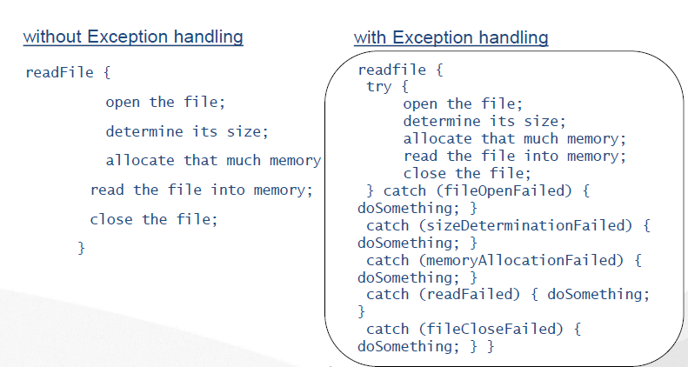

Slide 9
Syntax
Try
{
//block of code to monitor for error
}
catch(Exceptiontype1 e1)
{
//handler code
}
catch(Exceptiontype2 e2)
{
//handler code
}
.
.
.

Slide 10
catch(ExceptiontypeN eN)
{
//handler code
}
finally
{
//final handler code
}
Note : if non of these handler are capable to handle the exception then
Java default handler will handle the exception . JVM will display the error massage and terminate the program.

Slide 11
class Example
{
public static void main(String s[])
{
Scanner sc=new Scanner(System.in);
System.out.println("Enter First number");
int a=sc.nextInt();
System.out.println("Enter 2nd number");
int b=sc.nextInt();
try
{
int c=a/b;
}
catch(ArithmeticException ae)
{
System.out.println(“divided by 0”);
System.out.println(ae);
}
System.out.println(“after catch”);
}
}

Slide 12
class Example2
{
int a[][]=new int[3][3];
public void store()
{
try
{
for(int i=0;i<3;i++)
{
for(int j=0;j<5;j++)
{
//code
} } }
catch(ArraryIndexOutOfBoundsException aeo)
{
System.out.println(“out of bounds”+aeo);
}

Slide 13
Multiple catch
class Abc
{
public static void main(String args[])
{ c:\>java Abc
try O/P :
{ a=0
int a=args.length; arithmetic Exception msg
System.out.println(“arrary length is” + a); after catch
int b=12/a;
int c[]= new int[3];
c[12]=23;
}catch(ArithmeticException ae){ System.out.println(ae); }
catch(ArrayIndexOutOfBoundsException ae){ System.out.println(ae); }
System.out.println(“After catch”);
}
} c:\> java Abc test
O/P:
a=1
ArrayIndexOutOfBounds msg
After catch
Note : The Execution will stop after first exception .

Slide 14
Finally
class Abc
{
public static void main(String args[])
{
try
{
int a=0;
b=12/a;
}
catch(ArithmeticException ae){ System.out.println(ae); }
catch(ArrayIndexOutOfBoundsException ae){ System.out.println(ae); }
finally { System.out.println( “From finally”);
} }
Note : finally will execute whether exception is there or not .

Slide 15
Unreachable code
try
{
//code
}catch(Exception e){}
catch(ArithmeticException ae){}

Slide 16
throw
Till now we have worked with Exceptions thrown by JRE.By using “throw” we can explicitly throw an Exception.
class Account
{
void bal (int x)
{
try{
if (x<1000)
throw new ArithmeticException();
}catch(ArithmeticException ae){ S.O.P(“input is less than 1000” }
public static void main(String s[])
{ Account ob=new Account();
ob.bal(900);
}
}

Slide 17
throws
class Example
{
void meth1 (int x) throws ArithmeticException (will handle by main)
{
if (x<1000)
throw new ArithmeticException();
}
}
class B
{
public static void main(String s[]) //throws ArithmeticException(will handle //by JRE)
{
try {
Example ex=new Example();
ex.meth1(900);
}catch(ArithmeticException ae){ } }

Slide 18
Overriding “toString()” method
class a { }
Class b
{
public static void main(String s[])
{
a ob=new a();
System.out.println(ob); // will print class name@Hexadecimal code
}
}
Note : we can change this by overriding “toString()” method of Object Class
Class a
{
String toString()
{
return “welcome”;
}

Slide 19
Custom Exception
User define Exception class must inherit the “Exception” class.
Override the “toString()” method.
class LowBalException extends Exception
{
String toString()
{
return “amount is less than 1000”;
}
}
class Account
{
void bal (int x)
{
if(x<1000)
throw new LowBalException();
}
}

Slide 20
Checked & UnChecked Exceptions
Characteristics of Checked Exceptions:
They are checked by the compiler at the time of compilation.
They are inherited from the core Java class Exception.
They must be handled in your code, or passed to parent classes for handling.
Some examples of Checked exceptions include:
IOException, SQLException, ClassNotFoundException

Slide 21
Unchecked/Runtime Exceptions
Unchecked exceptions represent error conditions that are considered “fatal” to program execution.
Runtime exceptions are exceptions which are not detected at the time of Compilation.
They are encountered only when the program is in execution.
It is called unchecked exception because the compiler does not check to see if a method handles or throws these exceptions.
Exmaple : RuntimeException

